Slide 1
Stroke Predictor
Analysis and Classification of Strokes

Slide 2
Motivation and Stakeholders
Stroke: medical emergency caused by a lack to oxygen to the brain, often due to a blocked or ruptured artery
Strokes are a leading cause of disability and death worldwide
Damage/death may already be done before a treatment can be administered
Thus,
Large benefit if medical advisors were able to predict which patients were the most at-risk for having a stroke
Allow them to make recommendations for preventative medicines and lifestyle choices
Notes:
Millions of brain cells are lost per minute. Damage/death can be done before a person can even be treated.

Slide 3
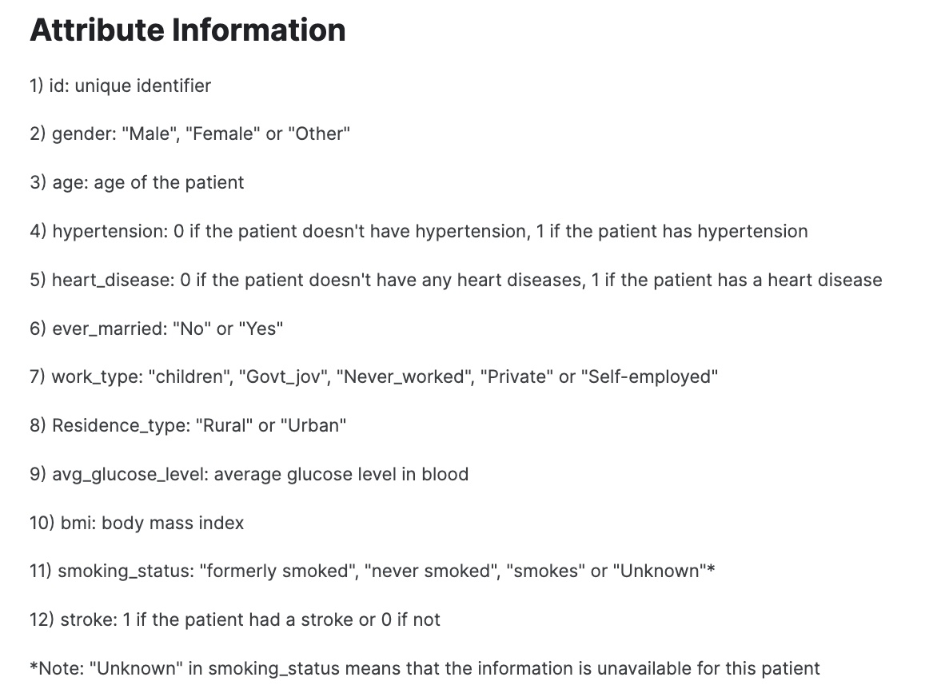
Data Overview
Each row in this dataset corresponds to information regarding an individual patient. This included some medical and lifestyle information.
Only around 1 in 20 patients experienced a stroke.
Notes:
If they ever married, if they have hypertension

Slide 4
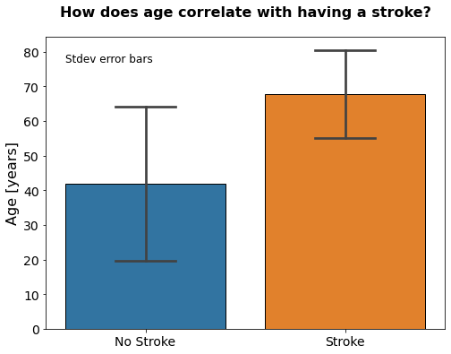
Key Findings

Slide 5
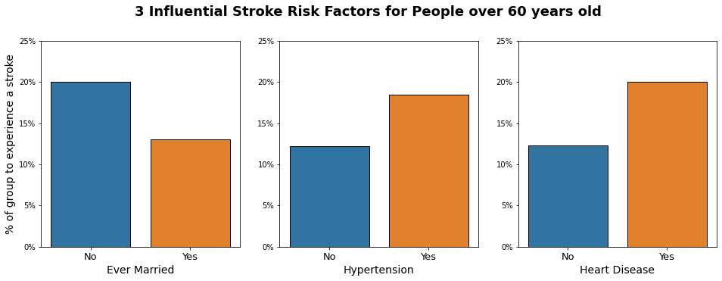
Key Findings

Slide 6
Model Performance
Model developer decision:
False negative are likely more costly than false positives
Caveat:
Model was not able to train on many positive cases due to class imbalance
Outcome:
Model greatly over predicts that the patient will have a stroke (see precision)
There are still some false negative predictions (see recall)
Metric | Value
Recall | 0.81
Precision | 0.13
Accuracy | 0.74
0 is worst, 1 is best
Notes:
For predicting strokes, it was deemed that False Negatives were costly than false positives. This is because a false negative would lead to some not getting the preventative care that they need.

Slide 7
Recommendations
Model predicts too many false negatives and false positives for it to be an extremely effective and high confidence tool
Depending on the risks of the preventative medications and treatments, this model should not be used to prescribe
That said, it could be used by a physician as an internal "at-risk" marking tool, allowing them to keep a closer eye on patients that may have a higher risk strokes
This may led to more extensive screenings to the extremely at-risk group which could potentially save lives.

